Slide 1
Module 3:
Databases
Sanket Singh SWE 2 @ Google

Slide 2
What will you learn
What is Consistent hashing?
Design a leaderboard

Slide 3

Let’s Design A Leaderboard

Slide 4
Basic Features ?
Let’s assume we are working in a gaming company for which we are designing a leaderboard.
We should be able to show ranking of users based on a score.
Users should be able to fetch their score.

Slide 5
Let’s say we want to design the following api
GET: /score?user_id=123
Let’s try a simple design

Slide 6
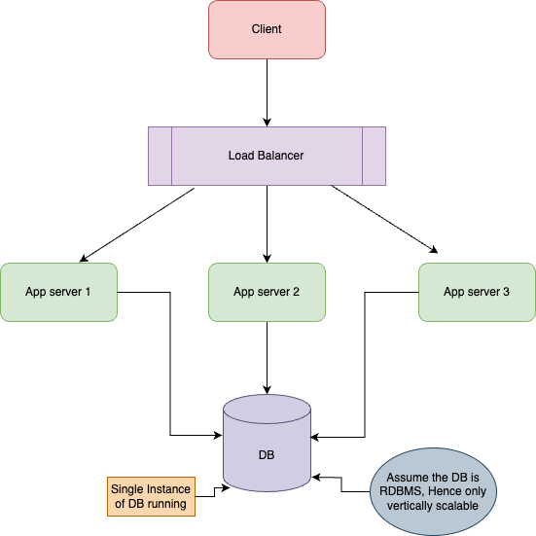

Slide 7
What problems can occur here ?
Load balancer is horizontally scalable using active-active and active-passive strategy
App servers are horizontally scalable
But DB is only vertically scalable, so if more number of requests comes up this can be our bottleneck as we can assume there will be limited number of cores on the DB server say 4, so only 4 parallel cores will work.

Slide 8
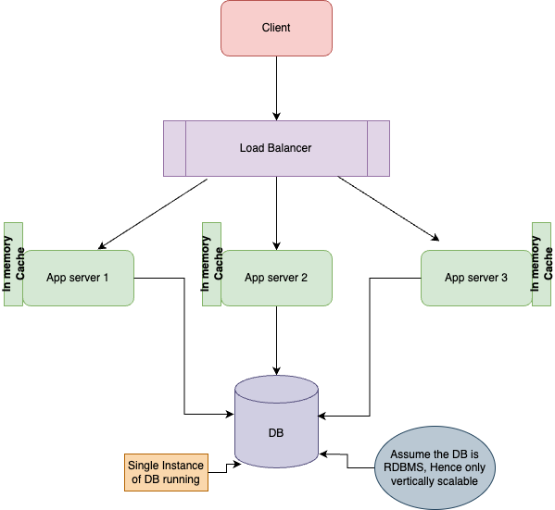
What if we add an in memory cache on app server?

Slide 9
How data update will work?
If an update comes we will first write to cache and then write to DB
If cache write fails we won’t write to db

Slide 10
Will it solve the problem?
But we can’t store data of all users in the cache otherwise it will take a lot of memory and cache have limited storage.
Consider u might be having 50GB kind of data.
In that case we might have to distribute the data on the app server, i.e. some user data will be on app server1, then some will be on app server2, and so on..

Slide 11
What problem will come with this ?
Now the LB cannot be stateless as the system is not stateless as LB needs to know which server contains data of what user ?
How LB knows which server is serving data of a User ?
A simple solution can be to have a mapping/table of user to server which will be queried by LB.
But this will add unnecessary I/O and wait time on LB Layer.

Slide 12
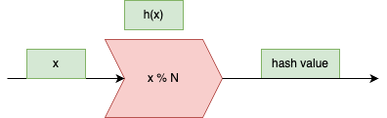
Let’s use hashing instead !!
Considering the number of app servers remain same always, any incoming request can be passed through a hash function and the hash value will denote the app server to route the request to.
We can achieve it by doing a modulo of number of app servers on the value.

Slide 13
What happens due to this ?
We don’t need any mapping to figure what server is serving data of a particular user.
Every time this hash function will return the same value considering N is same where N is number of app servers.
The pros is that it equally distributes data.
The cons are that if number of app servers change then we have to do a movement of data between app servers equivalent to that of rehashing.

Slide 14
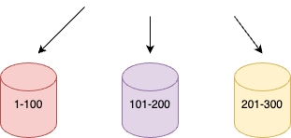
How about if we do range bucketting ?
Let’s assume the user_id is going to come in the range of (1-X) and we have N buckets (representing N servers) and we divide the number of requests equally say X = 300 and N = 3, so 1-100 in the first server, 101-200 in the second server and so on.
This approach also distributes the load equally.

Slide 15
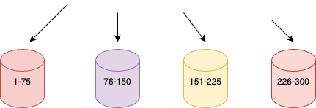
What if we add a new server
The load will be distributed again, but the movement of data will be drastically reduced.
Say we introduce one new server then load will be redistributed will less movement

Slide 16
Any advantages ?
This is a slightly better approach as the data transfer is relatively less.

Slide 17

Consistent hashing
Notes:
Consistent hashing is a distributed hashing scheme that operates independently of the number of servers or objects in a distributed network. It provides a way to distribute entries (like tables, indexes, or other data structures) into bins (servers, caches, processors, etc.) in a way that minimizes the need to reshuffle data when bins are added or removed. It's particularly useful in distributed caching systems and distributed databases to help achieve better load balancing and scalability.
Here's how basic consistent hashing works:
1. **Hash Space**: Imagine a circle (often called the "hash ring") where the position of each point on the circle corresponds to a hash value of the data item or server.
2. **Data Assignment**: Each data item (like a file or an entry in a database) is hashed to a point on the circle.
3. **Server Assignment**: Each server or cache in the system is also hashed to a point on the hash ring.
4. **Data Location**: To find out where a data item should be placed or retrieved from, the system will hash the data item to a point on the circle and then move clockwise around the circle until it finds the first server it encounters. This server is where the data item should be placed or fetched from.
5. **Adding Servers**: When a new server is added, it is hashed to a point on the circle. Only the data items that are located between the new server and the next server in the clockwise direction need to be moved to the new server. This is a small portion of the total dataset.
6. **Removing Servers**: When a server is removed, its range is taken over by the next server in the clockwise direction. Only the data that was stored on the removed server needs to be moved.
7. **Virtual Nodes**: To improve the uniformity of the distribution and avoid "hot spots" where a server gets a disproportionate amount of data, each server is often replicated into multiple "virtual nodes" and each virtual node is placed in a different position on the hash ring.
Basic consistent hashing has the following characteristics:
- **Load balancing**: It spreads load evenly across the servers.
- **Scalability**: It handles changes in the number of servers with minimal reorganization of data.
- **Decentralization**: It does not require a central coordinator; each server can work independently.
This hashing scheme is used by various distributed systems, such as DynamoDB by Amazon, the Chord distributed hash table, and the Akamai content delivery network.

Slide 18
Basic Consistent Hashing
Visualise it in form of a circle
We place the servers across the boundary of circles.
If we have N servers then we place our servers at (360/N) degree apart.
Example if we have 4 servers then they will be placed at 90 degrees from each other.
Notes:
Consistent hashing is a distributed hashing scheme that operates independently of the number of servers or objects in a distributed network. It provides a way to distribute entries (like tables, indexes, or other data structures) into bins (servers, caches, processors, etc.) in a way that minimizes the need to reshuffle data when bins are added or removed. It's particularly useful in distributed caching systems and distributed databases to help achieve better load balancing and scalability.
Here's how basic consistent hashing works:
1. **Hash Space**: Imagine a circle (often called the "hash ring") where the position of each point on the circle corresponds to a hash value of the data item or server.
2. **Data Assignment**: Each data item (like a file or an entry in a database) is hashed to a point on the circle.
3. **Server Assignment**: Each server or cache in the system is also hashed to a point on the hash ring.
4. **Data Location**: To find out where a data item should be placed or retrieved from, the system will hash the data item to a point on the circle and then move clockwise around the circle until it finds the first server it encounters. This server is where the data item should be placed or fetched from.
5. **Adding Servers**: When a new server is added, it is hashed to a point on the circle. Only the data items that are located between the new server and the next server in the clockwise direction need to be moved to the new server. This is a small portion of the total dataset.
6. **Removing Servers**: When a server is removed, its range is taken over by the next server in the clockwise direction. Only the data that was stored on the removed server needs to be moved.
7. **Virtual Nodes**: To improve the uniformity of the distribution and avoid "hot spots" where a server gets a disproportionate amount of data, each server is often replicated into multiple "virtual nodes" and each virtual node is placed in a different position on the hash ring.
Basic consistent hashing has the following characteristics:
- **Load balancing**: It spreads load evenly across the servers.
- **Scalability**: It handles changes in the number of servers with minimal reorganization of data.
- **Decentralization**: It does not require a central coordinator; each server can work independently.
This hashing scheme is used by various distributed systems, such as DynamoDB by Amazon, the Chord distributed hash table, and the Akamai content delivery network.

Slide 19
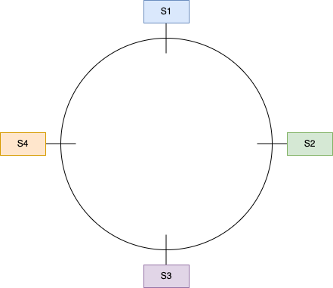
Notes:
Consistent hashing is a distributed hashing scheme that operates independently of the number of servers or objects in a distributed network. It provides a way to distribute entries (like tables, indexes, or other data structures) into bins (servers, caches, processors, etc.) in a way that minimizes the need to reshuffle data when bins are added or removed. It's particularly useful in distributed caching systems and distributed databases to help achieve better load balancing and scalability.
Here's how basic consistent hashing works:
1. **Hash Space**: Imagine a circle (often called the "hash ring") where the position of each point on the circle corresponds to a hash value of the data item or server.
2. **Data Assignment**: Each data item (like a file or an entry in a database) is hashed to a point on the circle.
3. **Server Assignment**: Each server or cache in the system is also hashed to a point on the hash ring.
4. **Data Location**: To find out where a data item should be placed or retrieved from, the system will hash the data item to a point on the circle and then move clockwise around the circle until it finds the first server it encounters. This server is where the data item should be placed or fetched from.
5. **Adding Servers**: When a new server is added, it is hashed to a point on the circle. Only the data items that are located between the new server and the next server in the clockwise direction need to be moved to the new server. This is a small portion of the total dataset.
6. **Removing Servers**: When a server is removed, its range is taken over by the next server in the clockwise direction. Only the data that was stored on the removed server needs to be moved.
7. **Virtual Nodes**: To improve the uniformity of the distribution and avoid "hot spots" where a server gets a disproportionate amount of data, each server is often replicated into multiple "virtual nodes" and each virtual node is placed in a different position on the hash ring.
Basic consistent hashing has the following characteristics:
- **Load balancing**: It spreads load evenly across the servers.
- **Scalability**: It handles changes in the number of servers with minimal reorganization of data.
- **Decentralization**: It does not require a central coordinator; each server can work independently.
This hashing scheme is used by various distributed systems, such as DynamoDB by Amazon, the Chord distributed hash table, and the Akamai content delivery network.

Slide 20
How requests will be handled ?
Whenever a request comes up, we calculate the hash of that request based on the user id as
hash(req) = req % 360
Then whatever value comes up will be in the range [0, 360) . Say we got a value X, we then find the nearest server in clockwise direction to that of X and this server will serve the request
Notes:
Consistent hashing is a distributed hashing scheme that operates independently of the number of servers or objects in a distributed network. It provides a way to distribute entries (like tables, indexes, or other data structures) into bins (servers, caches, processors, etc.) in a way that minimizes the need to reshuffle data when bins are added or removed. It's particularly useful in distributed caching systems and distributed databases to help achieve better load balancing and scalability.
Here's how basic consistent hashing works:
1. **Hash Space**: Imagine a circle (often called the "hash ring") where the position of each point on the circle corresponds to a hash value of the data item or server.
2. **Data Assignment**: Each data item (like a file or an entry in a database) is hashed to a point on the circle.
3. **Server Assignment**: Each server or cache in the system is also hashed to a point on the hash ring.
4. **Data Location**: To find out where a data item should be placed or retrieved from, the system will hash the data item to a point on the circle and then move clockwise around the circle until it finds the first server it encounters. This server is where the data item should be placed or fetched from.
5. **Adding Servers**: When a new server is added, it is hashed to a point on the circle. Only the data items that are located between the new server and the next server in the clockwise direction need to be moved to the new server. This is a small portion of the total dataset.
6. **Removing Servers**: When a server is removed, its range is taken over by the next server in the clockwise direction. Only the data that was stored on the removed server needs to be moved.
7. **Virtual Nodes**: To improve the uniformity of the distribution and avoid "hot spots" where a server gets a disproportionate amount of data, each server is often replicated into multiple "virtual nodes" and each virtual node is placed in a different position on the hash ring.
Basic consistent hashing has the following characteristics:
- **Load balancing**: It spreads load evenly across the servers.
- **Scalability**: It handles changes in the number of servers with minimal reorganization of data.
- **Decentralization**: It does not require a central coordinator; each server can work independently.
This hashing scheme is used by various distributed systems, such as DynamoDB by Amazon, the Chord distributed hash table, and the Akamai content delivery network.

Slide 21
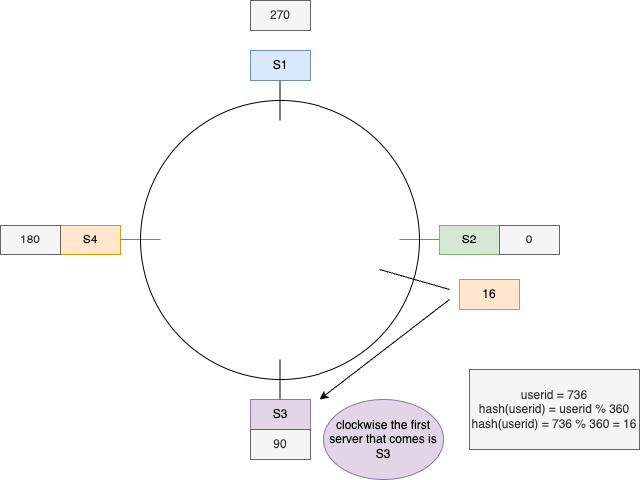
Notes:
Consistent hashing is a distributed hashing scheme that operates independently of the number of servers or objects in a distributed network. It provides a way to distribute entries (like tables, indexes, or other data structures) into bins (servers, caches, processors, etc.) in a way that minimizes the need to reshuffle data when bins are added or removed. It's particularly useful in distributed caching systems and distributed databases to help achieve better load balancing and scalability.
Here's how basic consistent hashing works:
1. **Hash Space**: Imagine a circle (often called the "hash ring") where the position of each point on the circle corresponds to a hash value of the data item or server.
2. **Data Assignment**: Each data item (like a file or an entry in a database) is hashed to a point on the circle.
3. **Server Assignment**: Each server or cache in the system is also hashed to a point on the hash ring.
4. **Data Location**: To find out where a data item should be placed or retrieved from, the system will hash the data item to a point on the circle and then move clockwise around the circle until it finds the first server it encounters. This server is where the data item should be placed or fetched from.
5. **Adding Servers**: When a new server is added, it is hashed to a point on the circle. Only the data items that are located between the new server and the next server in the clockwise direction need to be moved to the new server. This is a small portion of the total dataset.
6. **Removing Servers**: When a server is removed, its range is taken over by the next server in the clockwise direction. Only the data that was stored on the removed server needs to be moved.
7. **Virtual Nodes**: To improve the uniformity of the distribution and avoid "hot spots" where a server gets a disproportionate amount of data, each server is often replicated into multiple "virtual nodes" and each virtual node is placed in a different position on the hash ring.
Basic consistent hashing has the following characteristics:
- **Load balancing**: It spreads load evenly across the servers.
- **Scalability**: It handles changes in the number of servers with minimal reorganization of data.
- **Decentralization**: It does not require a central coordinator; each server can work independently.
This hashing scheme is used by various distributed systems, such as DynamoDB by Amazon, the Chord distributed hash table, and the Akamai content delivery network.

Slide 22
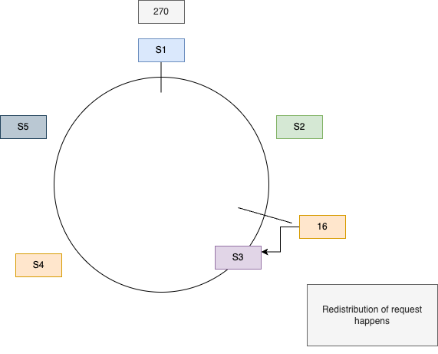
What if we add a new server ?
Notes:
When a new server is added to a system that uses consistent hashing, the process is designed to minimize disruption and the amount of data that needs to be moved. Here's what happens:
1. **Placement on the Hash Ring**: The new server is assigned a position on the hash ring. This position is determined by hashing the server's identifier, such as its IP address, hostname, or a server-specific string.
2. **Data Redistribution**:
- The new server takes over responsibility for data items whose keys are closest to it on the ring, moving in the clockwise direction.
- Specifically, the new server will take over the data items that were previously assigned to its immediate successor on the ring. The successor is the next server in the clockwise direction.
3. **Movement of Data**:
- Only the data items that fall between the new server and its immediate successor need to be moved to the new server.
- This usually means that only a fraction of the total number of data items needs to be transferred, which is proportional to the ratio of 1 over the total number of servers in the ring.
4. **Load Rebalancing**:
- The addition of a new server will rebalance the load across the servers. Each existing server will lose a portion of its data to the new server, potentially reducing the load on the other servers.
5. **Virtual Nodes**:
- If the system uses virtual nodes, the new server will have multiple points on the hash ring, which further helps in evenly distributing the data.
The beauty of consistent hashing is that it limits the reorganization of data to only the necessary items and the servers directly affected by the change, rather than a full redistribution. This makes the system more stable and reduces the overall system load associated with changes in the server setup.

Slide 23
Now let’s modify the logic now
Instead of placing the server on equal partition, let’s take hash of the server id’s as well and then whatever value comes, let’s place the server there.
hash(server_id) = (anything btw 0-10^18) % 360
Say we got the following hashes
S1-> 0 , S2 -> 27, S3 -> 128, S4 -> 190

Slide 24
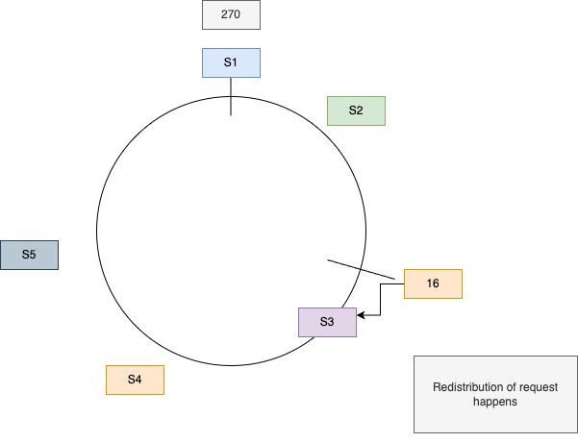

Slide 25
What benefit do we get ?
If we remove or add a new server, then we do not have to distribute data among all servers, as they still be having same hash functions.

Slide 26
Any problems ?
But then the requests won’t be routed equally as all the servers are at a diff distance from each other.
Adding a new server will not change the amount of load all the other servers are facing. It will only affect a single server.

Slide 27
Say previously all servers were having equal load
S1 -> 25%
S2 -> 25%
S3 -> 25%
S4 -> 25%

Slide 28
If we add a new server S5 btw S3 and S4
Then the load going to S4 will be redistributed between S4 and S5
S1 -> 25%
S2 -> 25%
S3 -> 25%
S5 -> 12.5%
S4 -> 12.5%
We might expect that adding a new server will reduce load on all servers but that will not happen

Slide 29
If we remove a server S3
Then the load going to S4 will be redistributed between S4 and S5
S1 -> 25%
S2 -> 25%
S3 -> 25% (removed)
S4 ->50%
Now removing the server increases the load on S4 as increase load is not equally distributed, now say S4 is not able to handle this load and crashes, then all the load goes to S1, and say it also crashes, then this will lead to a cascade of crashes.

Slide 30
How to resolve this ?
We can use the concept of virtual servers.
We can use multiple hash functions on a single server and create multiple virtual instances of those servers which might feel that the server is present on multiple locations.

Slide 31
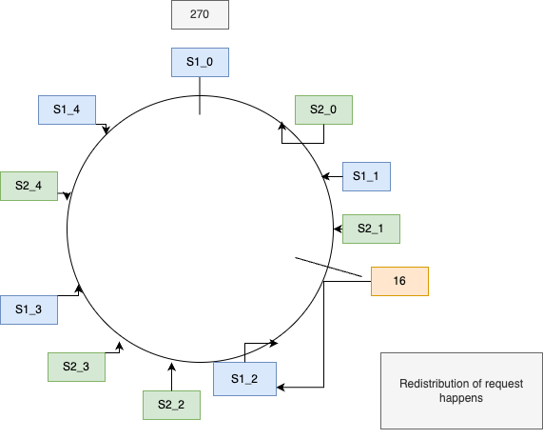

Slide 32
Adding and removing new servers
Adding or removing new servers doesn’t create uneven load, as every new server has multiple virtual locations due to the K different hash functions we are using.
Removal of node also distributed load equally among different virtual instances of the servers.

Slide 33
